Slide 1

INTRO TO ANALYTICAL MATHEMATICS
statistics and probability
central moments

Slide 2
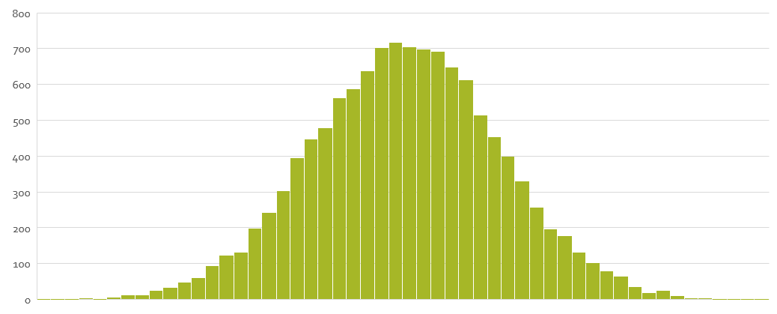
WHAT DOES IT MEAN TO BE NORMAL?
MEAN?
MEDIAN?
MODE?

Slide 3
THE MEDIAN
half are below it...
…and half are above it.
2
5
9
13
15
17
19
This is the middle observation.
The median is nothing more than the data point that has half the other data points below it and half the other data points above it.
That’s it.
No, really. There’s nothing more to it.

Slide 4
THE MODE
9
2
5
9
13
15
17
19
This is the value we have the most observations for.
There are 2 nines, and 1 of each other number.
The mode is the value that has the most instances (observations).

Slide 5
THE AVERAGE
So what’s an average?
There’s no one answer.
I’ll give you some of the more common types of average.
You’ve seen some of them before….

Slide 6

THE AVERAGE: MEANS
$$\overline{x}\left(m\right)={\left(\frac{1}{n}\sum_{i=1}^{n}{x_{i}^{m}}\right)}^{\frac{1}{m}}$$
A mean is this:
But there are MUCH easier ways of writing it.
And these go with the different types of means.

Slide 7

THE AVERAGE: ARITHMETIC MEAN
$$\overline{x}=\frac{\sum{x_{i}}}{n}$$
2
5
9
11.4
13
15
17
19
The arithmetic mean is the average we all learned in school.
Sum up the values and divide that sum by the count of observations.
The arithmetic mean is right about here.
There may be no actual number here.
Think of the mean as something like a numeric fulcrum. It’s where the line balances when these observations are sitting on it.

Slide 8

THE AVERAGE: GEOMETRIC MEAN
$$\overline{x}= \sqrt[n]{\prod{x_{i}}}$$
2
5
9
13
15
17
19
9.2
The geometric mean is an average used when outliers are a problem.
That’s why we often look at the geometric mean of something like inpatient length of stay.
The geometric mean is right about here.
There may be no actual number here.
Like the arithmetic mean, it’s a numeric fulcrum, balancing the line.
The difference: it’s not swayed as much by outliers.

Slide 9
THE AVERAGE: OTHER MEANS
$$\overline{x}\left(m\right)={\left(\frac{1}{n}\sum_{i=1}^{n}{x_{i}^{m}}\right)}^{\frac{1}{m}}$$
The arithmetic mean and geometric mean formulas come from this.
There are other means that come from this when m has other values.
Arithmetic mean: m=1.
But, there’s another type of arithmetic mean that arises frequently.
Quadratic mean (m=2),
Harmonic mean (m=-1).
Geometric mean: m→0.

